Slide 1


Database Management Systems
Transactions
Notes:
A big change on topic from previous slides

Slide 2
Transactions (executed unit work submitted by one personmultiple operations) trying to se consider if I have two tables, if one is correct another is wrong then our outcome will be false, inconsistent
◼ How many people are using our database?
– What problems can arise?
1. Accurate
2. Performance

Slide 3
Data Items
A transaction is a logical grouping of operations.
What is the piece of data being monitored by a transaction?
A record?
A column?
A page?
Two basic operations for each item: read and write
Notes:
Transaction is not Users that consider.

Slide 4
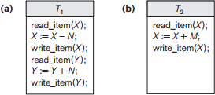
Transactions
Notes:
交叉进行

Slide 5
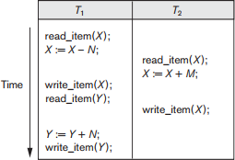
Lost Update Problem
Notes:
(git conflict)Try to update the same thing
“X:=X-N”
In memory
Not communicate with database directly

Slide 6
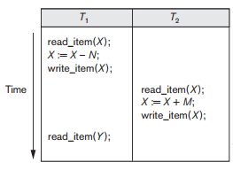
Temporary Update Problem
Notes:
If one crashed
Danger reason: Allow T2 to do the thing that is not safe to do so.

Slide 7
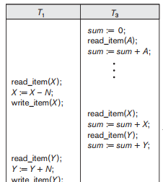
Incorrect Summary Problem
Notes:
Interfere

Slide 8
Unrepeatable Read Problem
◼ Occurs when same value is read twice, but modified in between
–We expect the result to be the same for both reads, but it is not
Notes:
If we have many people try to make operations on our data

Slide 9
Recovery
All statements must execute within a transaction
Committed
If a problem occurs that prevents a transaction from completing, we must undo our changes
What kinds of problems could occur?
Key constraints violation
All kinds of failure like server crash
Notes:
Before commit, it can be reverse, like bitcoin transaction vote.
Violate key constraints.
Server crash(natural disaster)

Slide 10
Transaction State
BEGIN TRANSACTION
READ OR WRITE
END TRANSACTION
COMMIT TRANSACTION
ROLLBACK

Slide 11
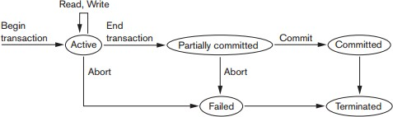
Transaction State
Notes:
Until Fully Commit
How to decide rollback (resource required)

Slide 12
Log Files
Sequential, append only list of transaction states
Each entry contains:
Transaction ID
State
Any data modifications that were made
This log is useful for
ROLLBACK: look back on the log file at exact time and redo
Recovery: E.g snapshot of backup (freq: once a day or once a month)

Slide 13
Properties of Transactions
◼ Often called ACID properties:
–Atomicity: everything in transaction or nothing
–Consistency Preservation: when trans is complete, invariant should not exist. E.g insert primary key/ foreign key
–Isolation: e.g., multiple transactions reading and writing to a table at the same time (reserve a ticket)
–Durability: ? log file
Notes:
How to make sure isolation???
At the same time (later slide schedule)

Slide 14
Schedules
A schedule is an ordering of the operations within a set of transactions
Operations from different transactions can be interleaved 交叉
Operations from a transaction must show up in the same order in the schedule
Lost Update Schedule r– read
– Sa: r1(X); r2(X); w1(X); r1(Y); w2(X); w1(Y);
Temporary Update Schedule
– Sb: r1(X); w1(X); r2(X); w2(X); r1(Y); a1;
Notes:
In parallel (concurrency)
You cannot disorder within a transaction

Slide 15
Conflicts
Operations are said to be in conflict if:
They belong to different transactions
They access the same item
At least one of the operations is a write
Two types
Read/write: one is trying to read another is to write
Write/write: ~
We must be aware of conflicts when forming schedules
Notes:
You can restrict one person to operate on the same data item but it’s impractical
We can be aware of but not forbid

Slide 16
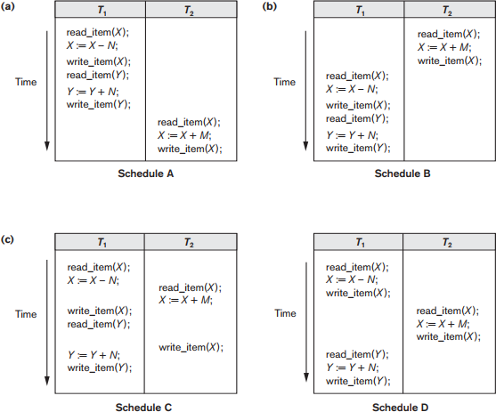
Serial vs. Nonserial Schedules
Notes:
One method is to force transaction serially
We prefer this because quite simple but not practical
How do I know this issue happen
Inclass question: Why serial exists conflict
It is natural to exist

Slide 17
Serializable Schedules
Serial Schedules are considered unnacceptable
–Why? Concurrency
We wish to use non-serial schedules, but guarantee the same outcome
–A serializable schedule is any schedule that is equivalent to a serial schedule(our goal)
But what defines equivalence?
Same data? (dangerous)
Non-serial schedules has the same conflict with serial ones

Slide 18
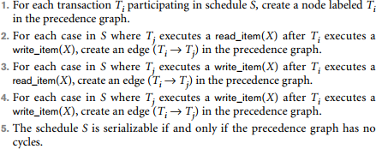
Conflict Serializable Test
Notes:
由先被check的指向后被check
Inclass question: Why cycle->ns conflict?

Slide 19
Practice Problem
◼ Run the conflict test for each schedule on slide 16
Serial vs. Non-serial Schedules
make a graph:
1. make nodes: two trans two nodes
2. CHECK: two types
3. cycle or not

Slide 20
Practice Problem
Not the same as any serialize schedule but exact one (A/D)
Notes:
CST: a nice tool
Not the Boolean Answer that we really care about
Inclass question What we really want to do: generate a serialize test(next MON)

Slide 21
Transactions in SQL
START TRANSACTION
COMMIT
ROLLBACK

Slide 22
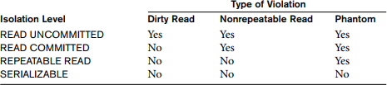
ISOLATION LEVEL
Notes:
Phantom (insertion):
Run the same query (if one insertion happens in between)

